Slide 1
Decision Tree Model
Nachiketh

Slide 2
Deciding whether to go to a Restaurant or home ?

Slide 3



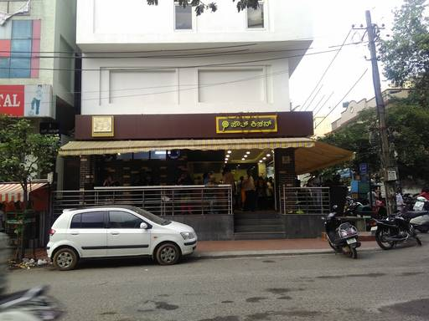

Decision Tree in Real Life
Hungry ?
Yes
No
Cash > 1000 INR
Go home & Sleep
No
Yes
South Kitchen
Novotel

Slide 4
Decision Tree
A Decision Tree is a simple representation for classifying examples. It is a Supervised Machine Learning where the data is continuously split according to a certain parameter.

Slide 5
Each Decision Tree Contains
Nodes : Test for the value of a certain attribute.
Edges/ Branch : Correspond to the outcome of a test and connect to the next node or leaf.
Leaf nodes : Terminal nodes that predict the outcome (represent class labels or class distribution).

Slide 6
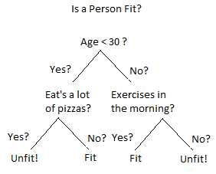
Decision Tree - Example 2
Root Node
Check Wheter the person is fit or not ?

Slide 7

Parts of Decision Tree

Slide 8
Types of Decision Tree
Classification Trees (Yes/No)
Binary recursive partitioning. An iterative process to split the data into partitions
Regression Decision Trees (Predicting a Real Value)
The partition of the data space into cluster (or dense) regions and empty (or Sparse) regions

Slide 9

Method Followed

Slide 10
Basic Working of Divide & Conquer Rule
Select a test for root node. Create branch for each possible outcome of the test.
Split instances into subsets. One for each branch extending from the node.
Repeat recursively for each branch, using only instances that reach the branch.
Stop recursion for a branch if all its instances have the same class.

Slide 11
Steps for generating Decision Tree
Start with Complete Training data in the root node
Decide on measure of impurity (Gini Impurity Index or Entropy ). Search for predictor variable that minimizes the impurity.
Repeat step 2 for each subset of the data until :
All dependent variables are exhausted
Stopping criteria are met
Generate Business Rules for the leaf

Slide 12
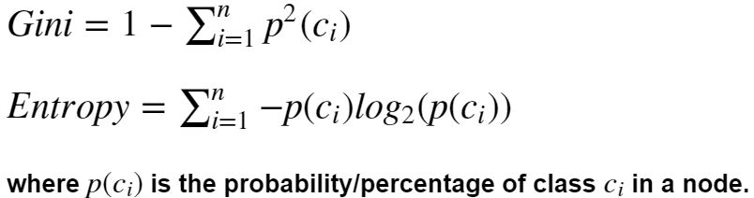
Gini Impurity Index & Entropy

Slide 13
Prerequisites - Run the Commands on Anaconda Prompt
Pydotplus
$ conda install pydotplus
GraphViz
$ conda install -c anaconda graphviz

Slide 14
Dataset
Breast Cancer Wisconsin (Diagnostic) Data Set
Importing the Data:
from sklearn.datasets import load_breast_cancer
cancer = load_breast_cancer()

Slide 15
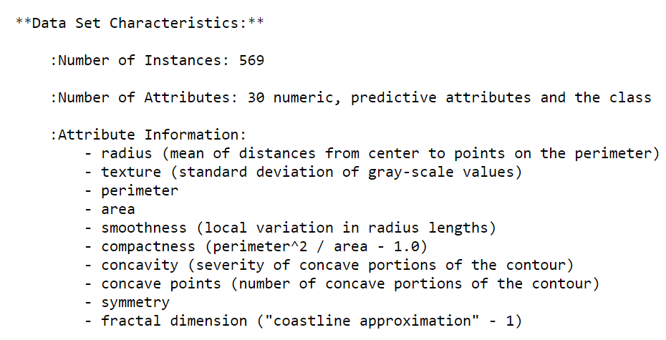
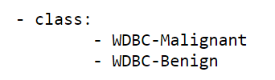
About the Dataset
Malignant = 0
Benign = 1

Slide 16
Hands-On Implementation

Slide 17
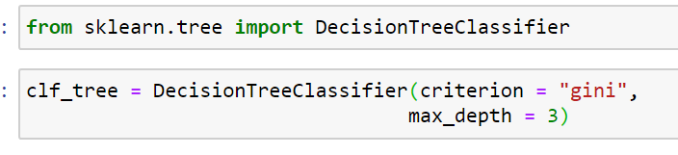

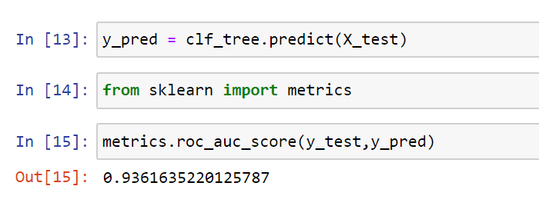
Model Initialization
2. Fit
3. Predict and Evaluate

Slide 18
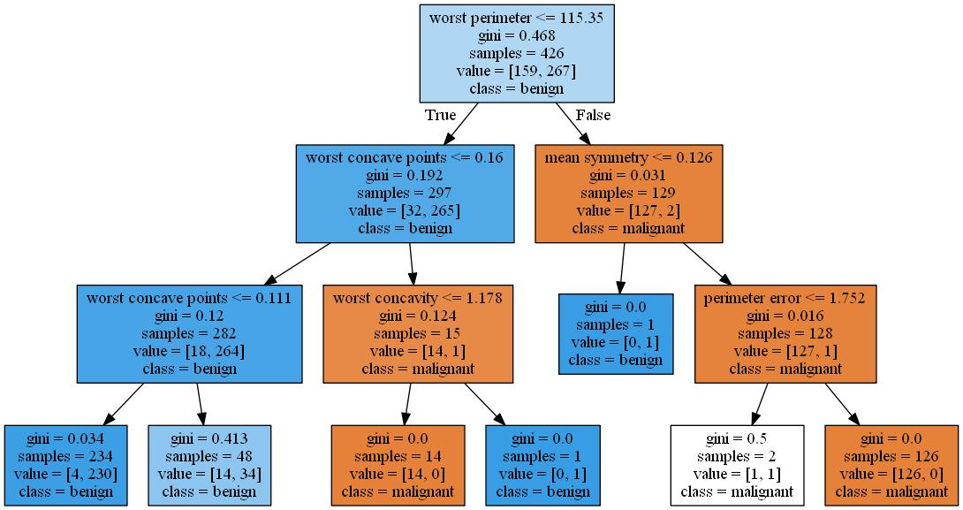
Generate Decision Tree

Slide 19
GridSearchCV - Hyperparameter Tuning
Grid search is the process of performing hyper parameter tuning in order to determine the optimal values for a given model. This is significant as the performance of the entire model is based on the hyper parameter values specified.

Slide 20
Arguments for GridSearchCV
estimator : A scikit-learn model which implements the estimator interface - ML Model
param_grid : A dictionary with parameter names (string) as keys and lists of parameter settings to try as values
scoring : Is a string ; an accuracy measure : i.e, roc_auc
cv : integer values (Specifies the number of folds for k-fold)

Slide 21
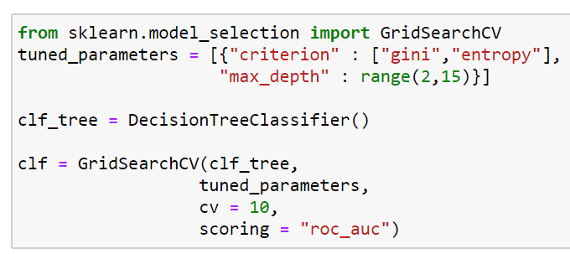
GridSearchCV

Slide 22
Advantages of Decision Tree
Easy to interpret for small-sized trees
Accuracy comparable to other classification techniques for many simple data sets.
Inexpensive to construct.
Extremely fast at classifying unknown records.
Excludes unimportant features.

Slide 23
Disadvantages of Classification with Decision Trees:
Decision tree models are often biased toward splits on features having a large number of levels.
Small changes in the training data can result in large changes to decision logic.
Easy to overfit.
Decision Boundary restricted to being parallel to attribute axes.
Large trees can be difficult to interpret and the decisions they make may seem counter intuitive.

